Slide 1
Data Scientist Salary Analysis
Mike Steyer
November 2024

Slide 2
Agenda
Objective & Assumptions
Dataset Analysis
Trends
Current Market State
Recommendations

Slide 3
Objective & assumptions
Determine an appropriate salary for a new data scientist position(s) within the firm
One full-time leadership position
Possibility of additional team members
Evaluate offshore vs domestic hires

Slide 4
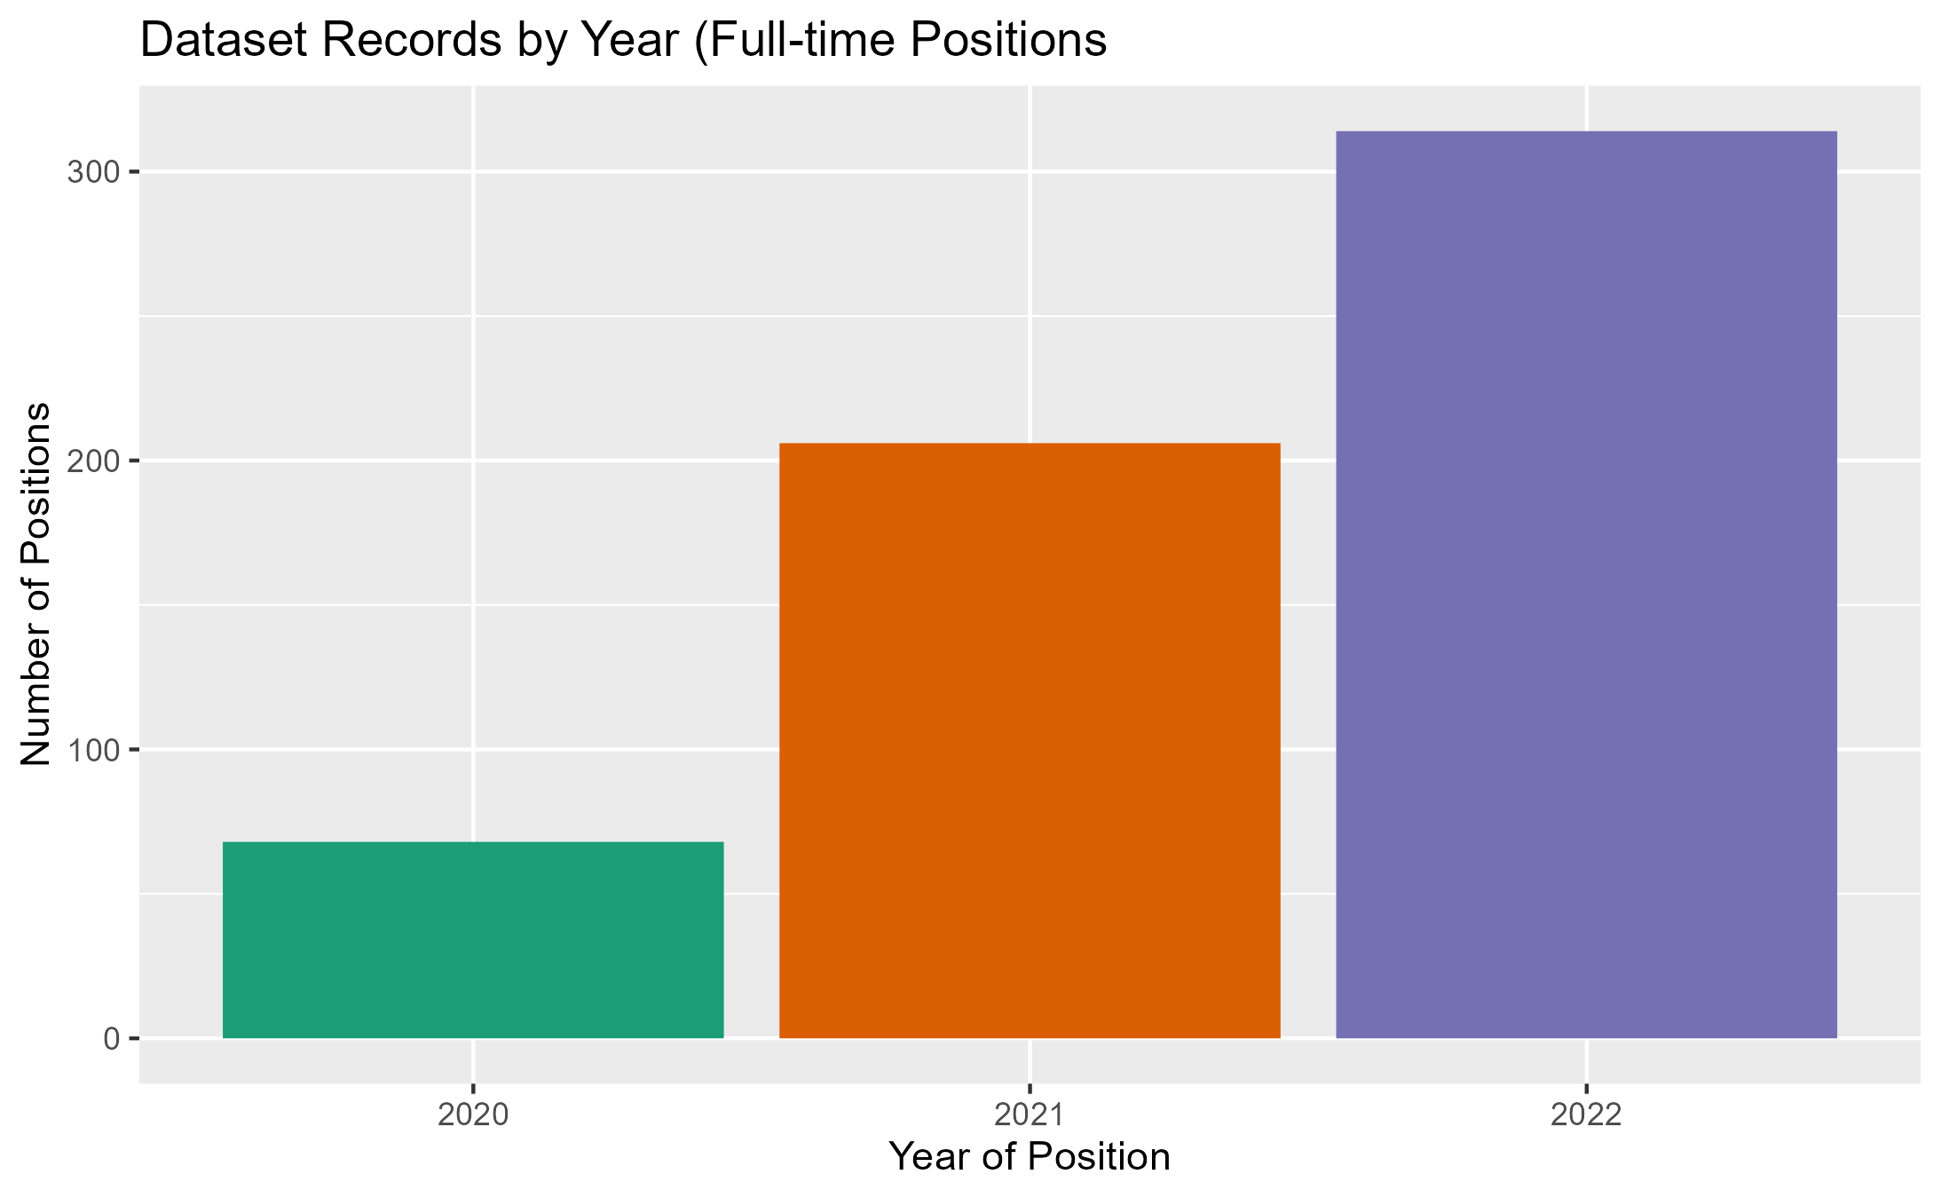
Dataset analysis
Provided with a set of 607 historical positions within the data science field between 2020 & 2022 (inclusive)
Filtered this set to only include full-time positions, bringing the total to 588 records

Slide 5
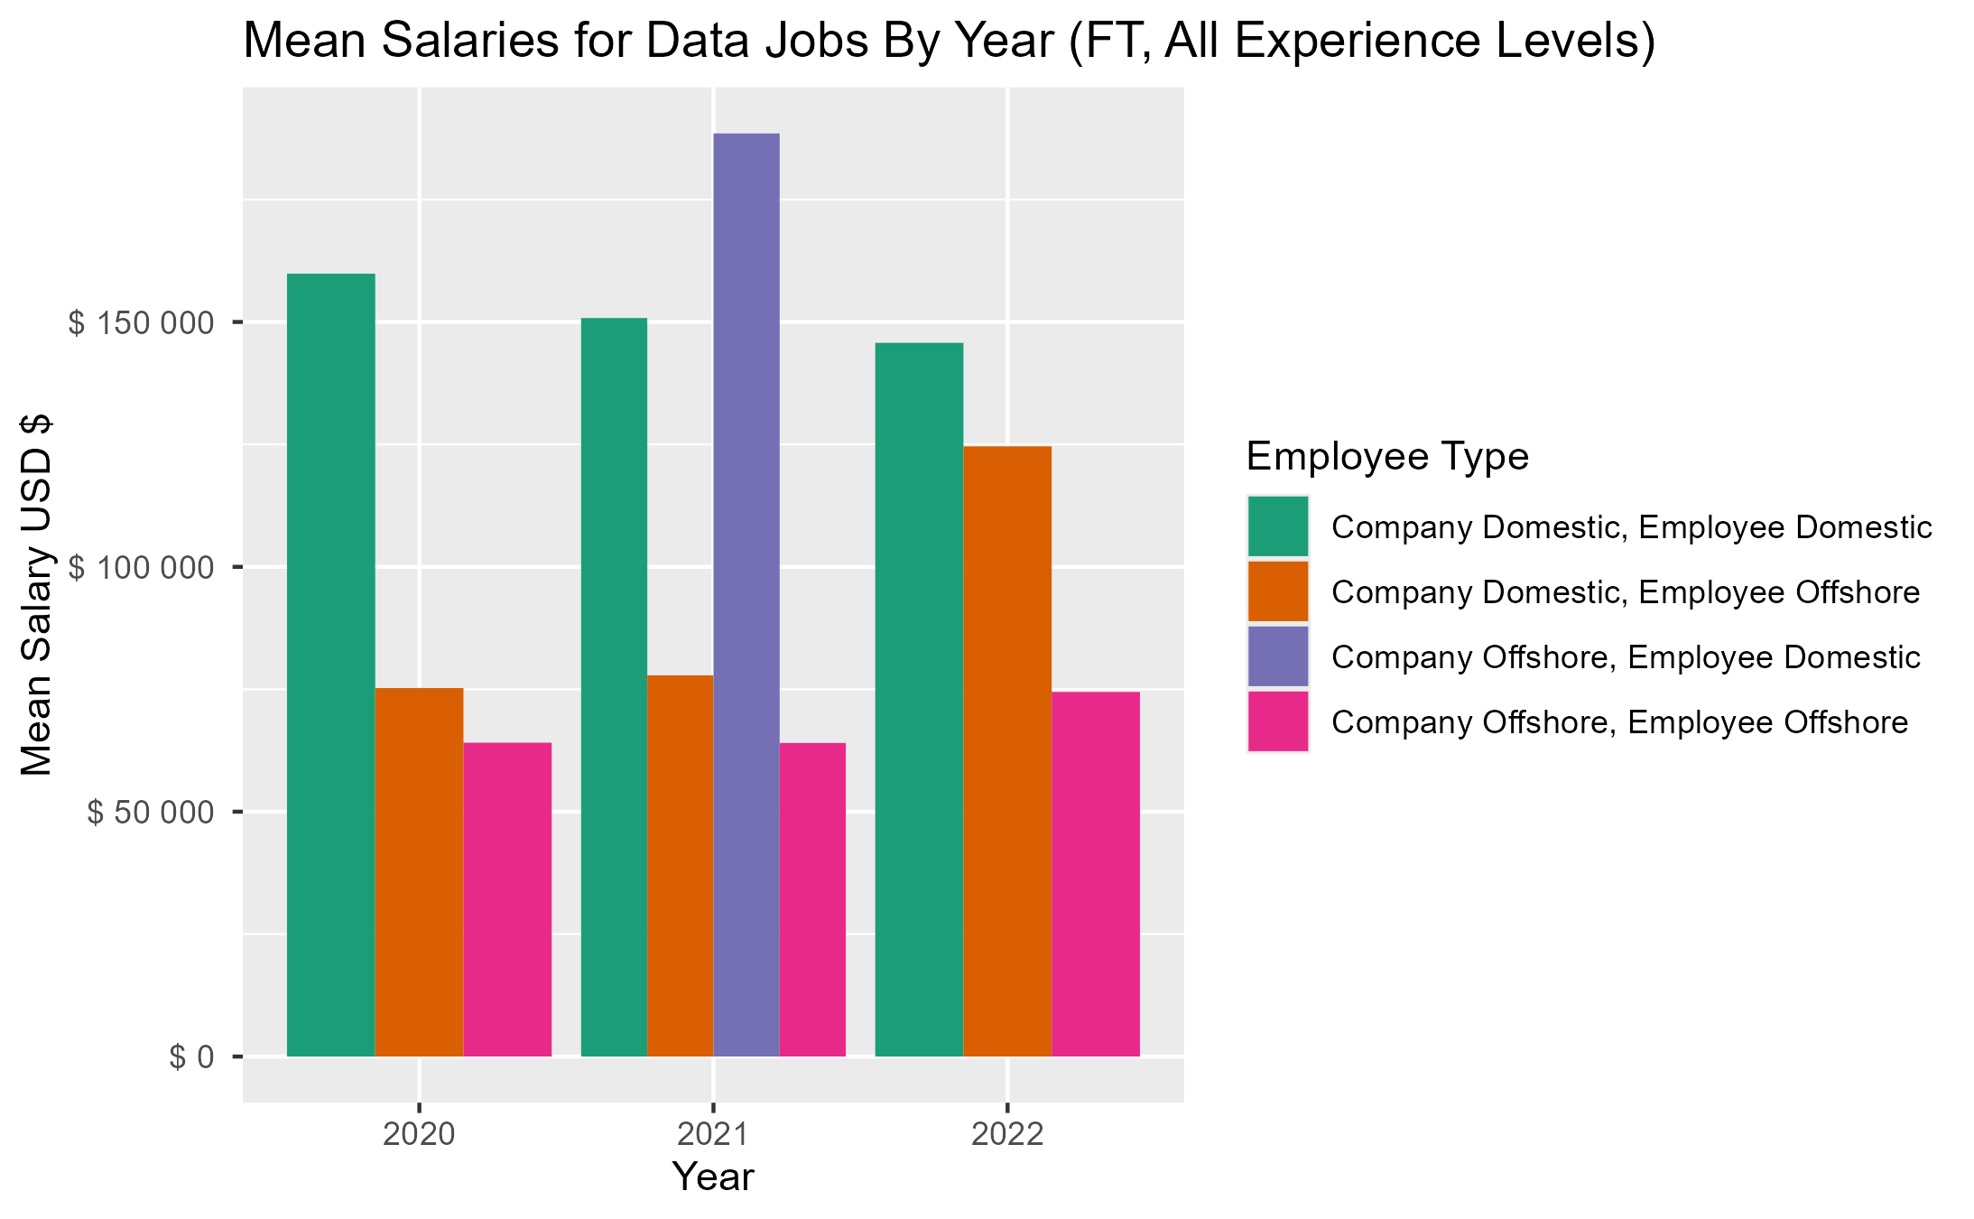
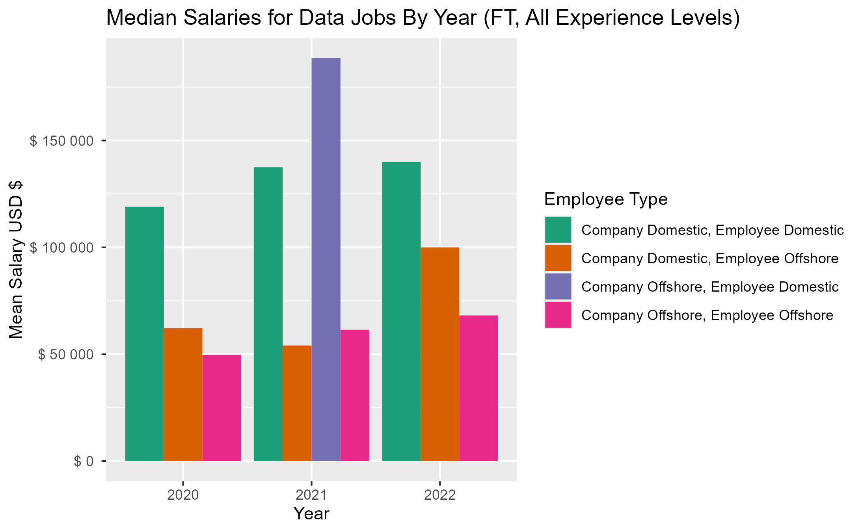
trends
These graphs show the location of the employee & company for the job listings and the salary differences over time.
Domestic salaries have largely remained flat, while offshore employees have seen a bump in salary when working for a US company.
US-based companies pay data scientists more than non-US companies.

Slide 6
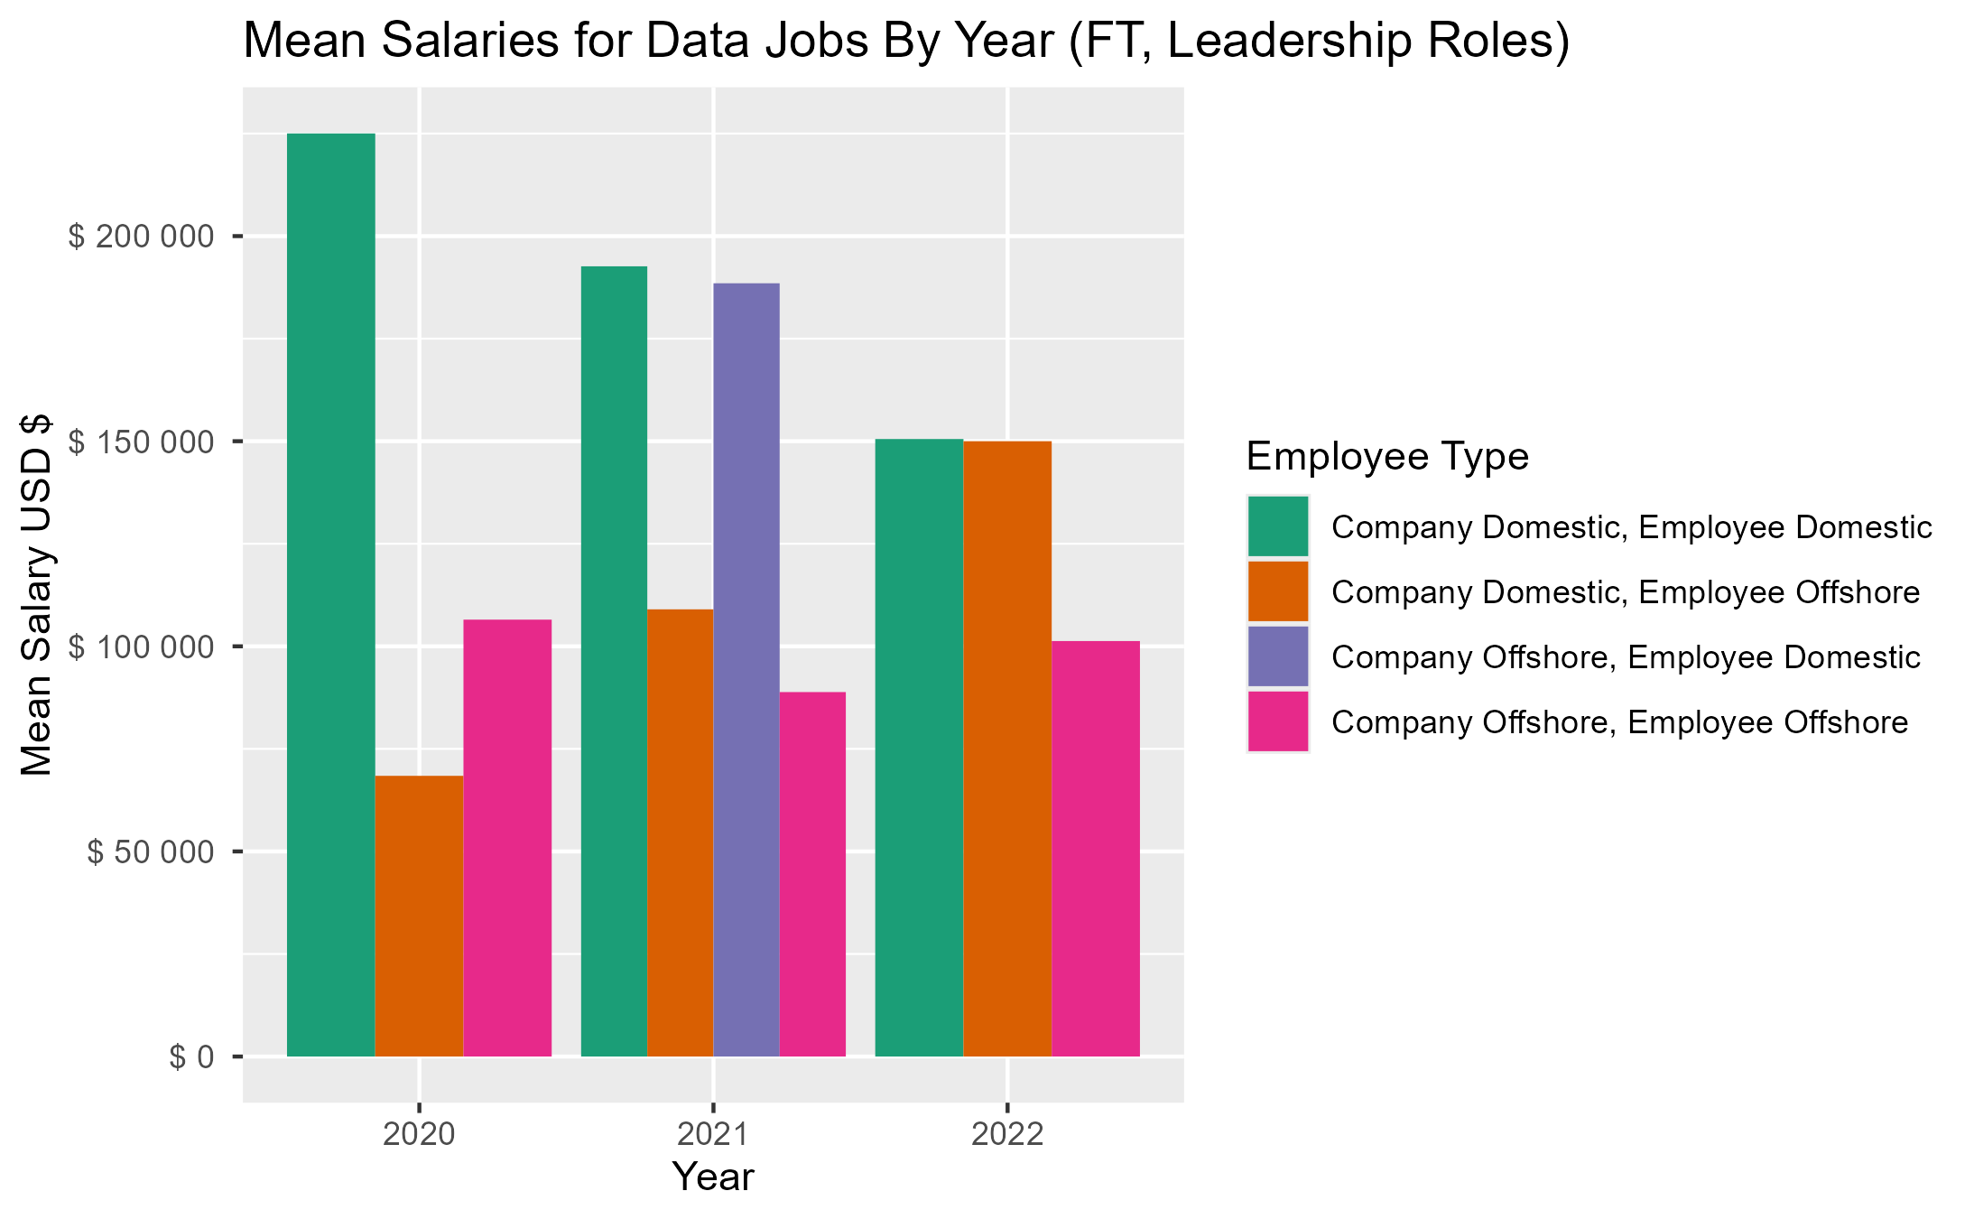
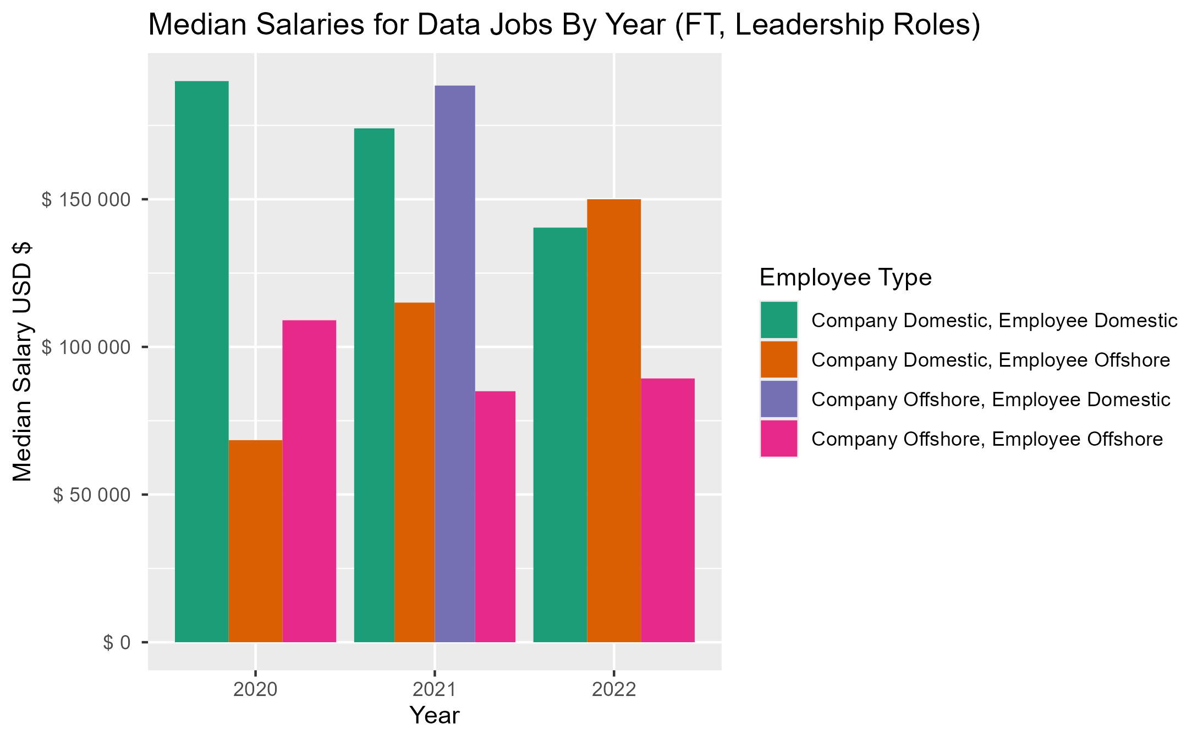
trends
These graphs show the location of the employee & company for the job listings and the salary differences over time, but only for “leadership positions”.
Leadership positions are defined as those in “senior” or “expert” levels of experience.
Domestic salaries have fallen considerably, while offshore employees have seen a significant bump in salary over time.
US-based companies pay data scientists more than non-US companies.

Slide 7
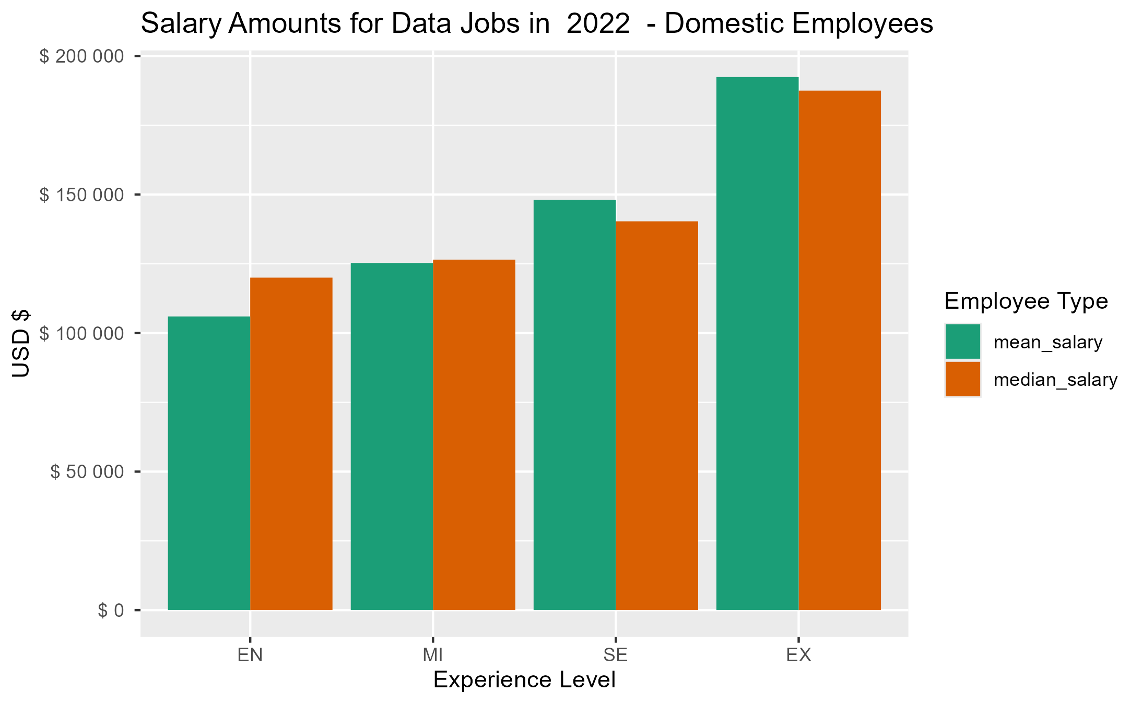
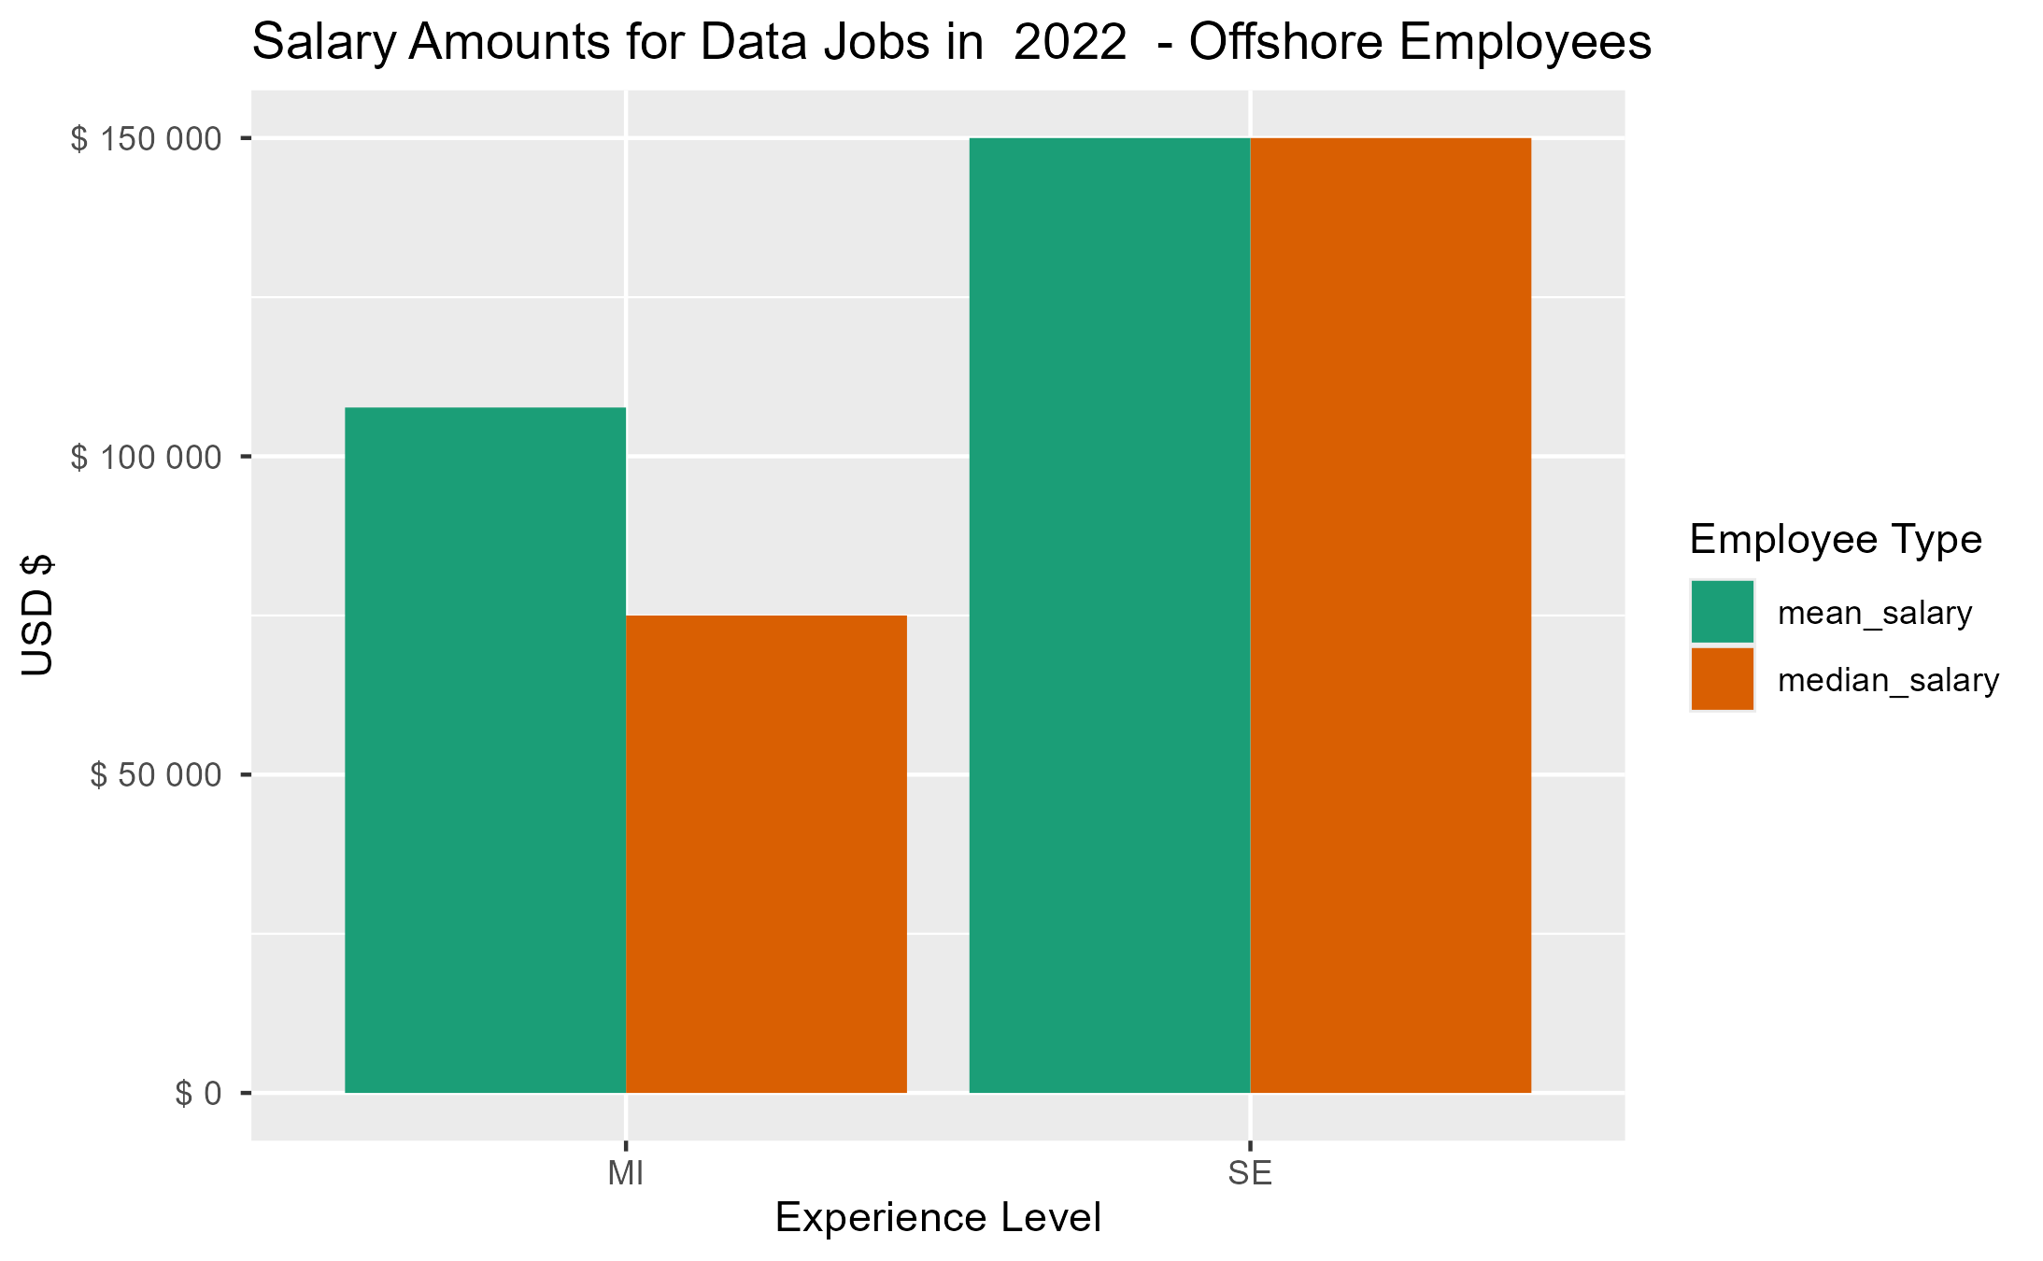
Current market state
These charts represent the listings pertaining to domestic-based companies only (to align with our firm’s requirements). They show data from 2022 (the latest year data was available).
Unfortunately, no data was available for expert-level offshore positions.
The data available indicates that median salaries for mid-level experience employees differ drastically between domestic & offshore positions. However, senior levels are near parity.

Slide 8
Recommendations
Leadership position salaries have decreased over the last several years. Salaries in a leadership level of experience are nearly equal between offshore and domestic positions.
Domestic & Offshore: ~$150,000
Entry level & mid-level positions benefit from a considerable cost savings when using offshore talent.
Domestic: ~$120,000
Offshore: ~$75,000

Slide 9
Selecting visual aids
Enhancing your presentation

Slide 10
Navigating Q&A sessions
Know your material in advance​
Anticipate common questions​
Rehearse your responses
Maintaining composure during the Q&A session is essential for projecting confidence and authority. Consider the following tips for staying composed:​
Stay calm​
Actively listen​
Pause and reflect​
Maintain eye contact

Slide 11

Speaking impact​
Your ability to communicate effectively will leave a lasting impact on your audience​
Effectively communicating involves not only delivering a message but also resonating with the experiences, values, and emotions of those listening

Slide 12
Dynamic delivery​
Learn to infuse energy into your delivery to leave a lasting impression​
One of the goals of effective communication is to motivate your audience
Metric​ | Measurement​ | Target​ | Actual​
Audience attendance​ | # of attendees​ | 150​ | 120​
Engagement duration​ | Minutes​ | 60​ | 75​
Q&A interaction​ | # of questions​ | 10​ | 15​
Positive feedback​ | Percentage (%)​ | 90​ | 95​

Slide 13
Final tips & takeaways​
Consistent rehearsal​
Practice makes perfect, so strengthen your familiarity with the presentation​
Refine delivery style​
Pacing, tone, and emphasis​
Timing and transitions​
Aim for seamless, professional delivery​
Practice audience
Enlist colleagues to listen & provide feedback​
Seek feedback​
Reflect on performance​
Explore new techniques​
Set personal goals​
Iterate and adapt

Slide 14
Speaking engagement metrics​
Impact factor​ | Measurement​ | Target​ | Achieved​
Audience interaction​ | Percentage (%)​ | 85​ | 88​
Knowledge retention​ | Percentage (%)​ | 75​ | 80​
Post-presentation surveys​ | Average rating​ | 4.2​ | 4.5​
Referral rate​ | Percentage (%)​ | 10​ | 12​

Slide 15
THANK YOU
Brita Tamm​
502-555-0152​
brita@firstupconsultants.com​
www.firstupconsultants.com

